Slide 1

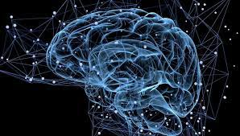

Name of the project

Slide 2
Title
Immersive
Team 42 - Rapsberry
Adrien Dani Seb Samy Laurence

Slide 3
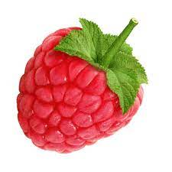
Please delete this slide when delivering
Rapsberry_NTXHACK22
All slide decks delivered must follow this naming order: Rapsberry_NTXHACK22
Feel free to change the slide titles, to best explain your project
Charts, data visualizations, drawings, sketches, images, and all visual content is encouraged
Hyperlinks to datasheets, further documentation, and process is accepted, nevertheless, the project will be judged primarily through the content in the slides

Slide 4
The Problem : How to create an immersive link between computer interface and human body signals.
Who is affected?
How are they affected? : The goal is to let everyone communicate in a non with the interface through body signals. It will
Why is this important/interesting to solve?
What impact can it have if successful? : In life people interact with non spoken signals such as corporal language, micro expression and

Slide 5
The Problem : How to create an immersive link between computer interface and human body signals.
Our first goal is to help people with a lack or loss of autonomy: paralysed, disabled, elderly.
= enabling to regain their autonomy and a certain level of freedom to act at a very simple level.
Who is affected? People with defective or reduced or absent mobility of the upper limbs: paralytics, hemiplegics, Parkinson's etc. ....
XXXX allows the processing of signals from the jaw and / or posterior areas of the brain - electroencephalogram and to associate a menu allowing actions.
Applications:
activate home automation elements: activate a light, a door .... example: activate the flashlight of his phone,
guide the movement of his wheelchair,
activate the movements of his hexoskeleton
- Why is this important/interesting to solve? Reducing dependency, increasing autonomy seems to us an important challenge to solve.
Rapsberry_NTXHACK22

Slide 6
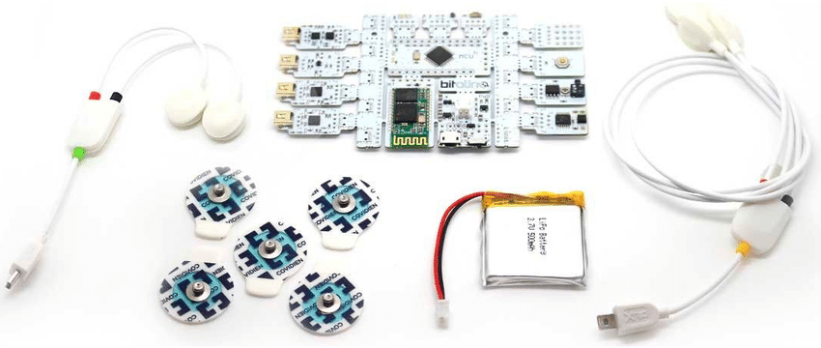
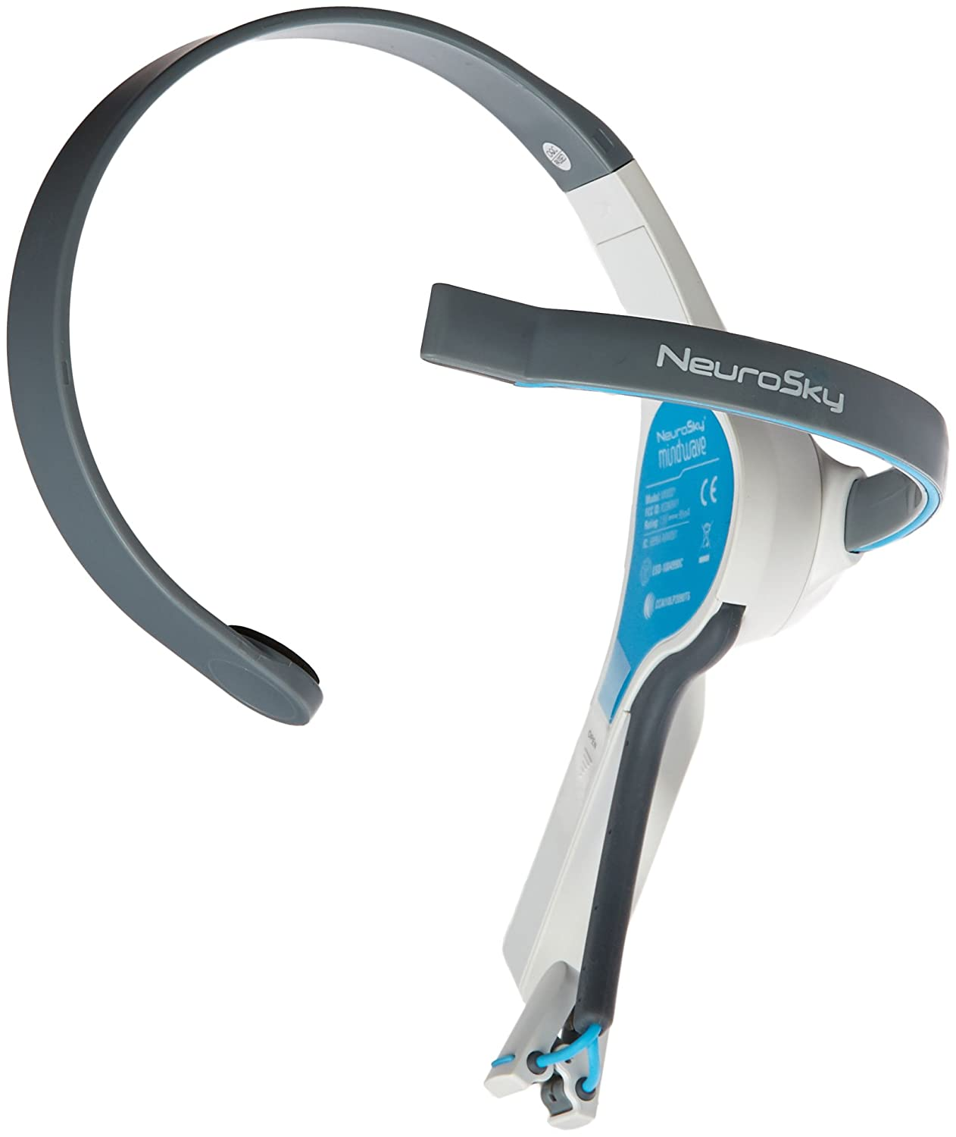
The Solution
How does it address the problem?
a virtual assistant that converts signals into output for various applications
The input are either a signal from the jaws, or from the brain or from both (distinct signal profiles).
A ON/OFF sequence to activate recording signals transmitted from electrodes (3 or 5) or a helmet
A customizable menu that propose items to choose from
Rapsberry_NTXHACK22

Slide 7
Current developments
- How successfully can it solve different aspects of the problem?
- activate the acquisition system on demand
- customize the content of the proposed menus and applications with an API
- choose the activation mode according to a motor deficit or a contemporary activity (e.g. do not activate the brain module when it is busy with another function)
- What benefits and limitations are there?
- benefits: autonomy, mobility,
- limitations : /// pre choisi ///// ??????
- person with non-reduced mobility: domotic, activate services
- when driving: using the jaw module requires less neurological capacity than a mobile phone or a conversation
- assistance in certain areas of activity where the hands are occupied
- algorithms:
. finer analysis of the signal from the brain
. propose more developed algorithms and functionalities on logical or more complex modes (e.g. propose a series of linked actions such as turning off the lights, closing the door and the shutters)

Slide 8
How it works

Slide 9
Documentation
Github / Design link if applicable
Description of solution

